Slide 1

UNIVERSITY ACADEMIC MANAGEMENT SYSTEM
A Database Management System Project
Preseed By:
T.Harideep Raju
P.Sai Charan
R.Srinivasa swamy M.Trilok Pavan
Under the guidance of:
Mrs Gayathri Lakshmi Narasamba Vonguri
Department of Artificial Intelligence and Machine Learning
Aditya University
Academic Year: 2026–27

Slide 2
Abstract
The University Academic Management System is a DBMS-based project designed to manage university academic information in a structured database. It stores details of students, faculty, departments, courses, enrollments, and results. The system uses Primary Keys and Foreign Keys to establish relationships and maintain data consistency.

Slide 3
Objectives
To design a structured database for university academic information.
To manage students, faculty, departments, courses, enrollments, and results.
To establish relationships using Primary Keys and Foreign Keys.
To reduce data redundancy and maintain data consistency.
To enable easy storage and retrieval of academic records.

Slide 4
Problem Statement
Scattered academic records
Data redundancy
Difficult data retrieval
Data inconsistency
Manual record management

Slide 5
Existing System
Academic records are often maintained using manual or separate systems.
Information may be scattered across different records.
Updating and retrieving records can be time-consuming.
Manual management can lead to data redundancy and errors.
Maintaining relationships between academic records is difficult.

Slide 6
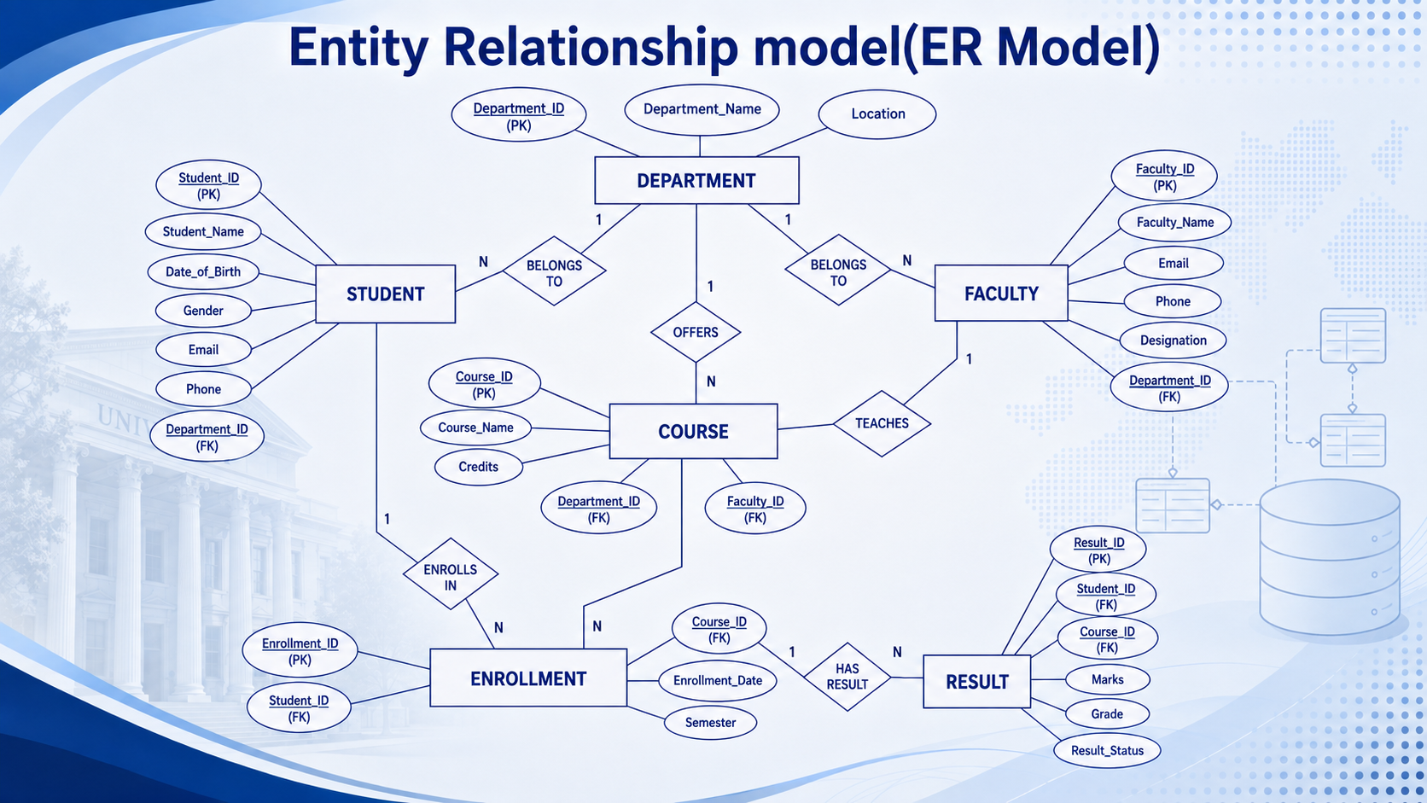

Slide 7
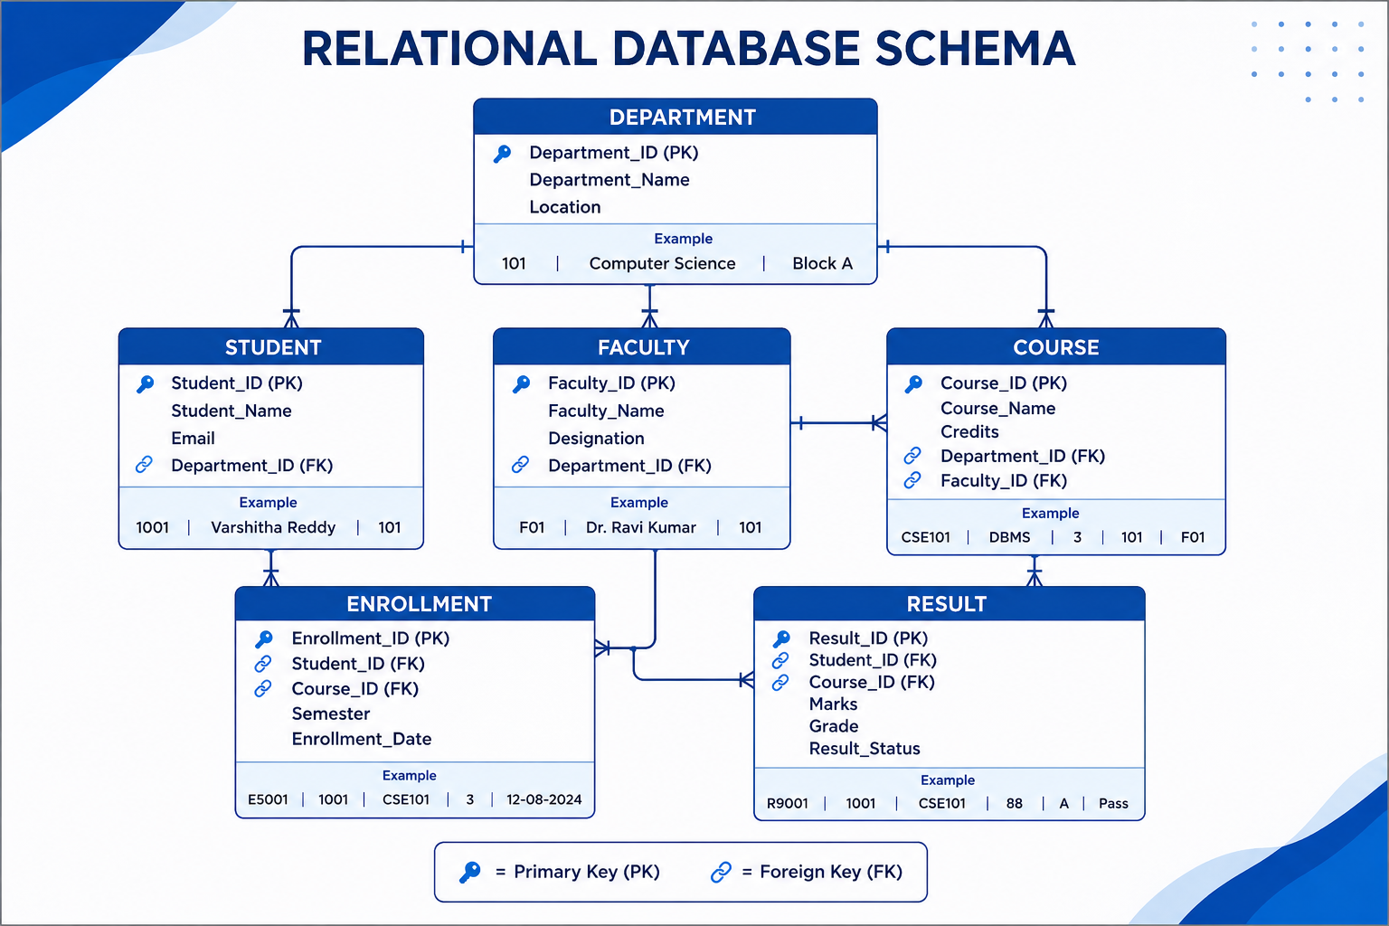

Slide 8
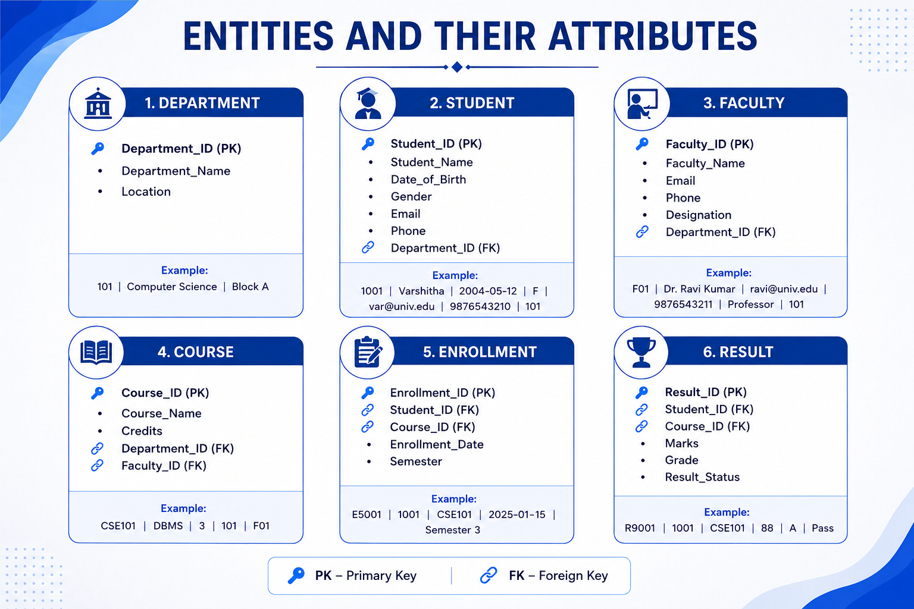

Slide 9

Primary Keys & Foreign Keys
🔑 Primary Key (PK)
A Primary Key uniquely identifies each record in a table.
Examples:
Department → Department_ID
Student → Student_ID
Faculty → Faculty_ID
Course → Course_ID
Enrollment → Enrollment_ID
Result → Result_ID
🔗 Foreign Key (FK)
A Foreign Key connects two related tables by referencing the Primary Key of another table.
Examples:
Student.Department_ID → Department.Department_ID
Enrollment.Student_ID → Student.Student_ID
Enrollment.Course_ID → Course.Course_ID
Result.Student_ID → Student.Student_ID
Result.Course_ID → Course.Course_ID

Slide 10
GitHub Repository & Team Responsibilities
💻 GitHub Repository
Repository:
University-Academic-Management-System
Purpose:
To store and manage the project's database design, documentation, source files, and presentation in a centralized repository.
📸 [Place GitHub repository screenshot here]
👥 Team Responsibilities
K. Tripura → ER Diagram & Database Design
M. Bhagaya Satya Sri → Relational Schema & SQL
P. Surya Varshitha → Documentation & PPT
M. Veeresh → GitHub Repository & Project Integration

Slide 11


